Slide 1

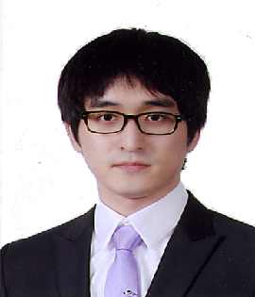
PORTFOLIO
Young-Duk Seo Assistant Professor, Dept. of Data Science, Sejong University

Slide 2
Index
Young-Duk Seo
Personal history
Research interest
Overall research plans
Recommender system
Big data analysis
Smart greenhouse system
Lecture plan

Slide 3
Young-Duk Seo
I. Personal history

Slide 4



Career of Young-Duk Seo Personal history
I
Young-Duk Seo
2008.3 ~ 2012. 2
B.S
Computer & communication engineering, Korea university
2012.3 ~ 2018. 2
Ph.D
Computer science & engineering, Korea university
2018. 9 ~ 2019. 2
Post-doc
Computer & information security, Sejong university
2018. 3 ~ 2018. 8
Research professor
Computer, information & communication research institute, Korea university
2012. 6 ~ 2013. 12
Found start-up company
I-Model – IT project manager
Young-Duk Seo 2019
Big data
A.I.
IT convergence
Assistant professor,
Data Science, Sejong university
Recommender system
Big data analysis research
Smart greenhouse

Slide 5
Young-Duk Seo
II. Research interests
Overall research plans for next 2 years

Slide 6
Overall research plans
Young-Duk Seo
IPTV recommender system
Personalized recommender system in various domains
Personalized recommendation
Personalized recommender system based on friendship strength
Evaluating friendship strength with matrix factorization
Tensor factorization via friendship strength
Recommender system
Personalized recommender system via tensor factorization
Group recommendation
Upward leveling (UL) aggregation method
Group recommendation based on matrix factorization
Group recommendation based on tensor factorization
Entity linking
Entity linking for short textual data based on similarity among users
Entity linking for short textual data using a set of similar documents
Entity linking for short textual data using online learning
Big data
analysis
Real data analysis
Fine dust data analysis through mobile sensor
Analysis of correlation between fine dust and disease
Analysis of correlation between humidity and disease
Smart greenhouse
Smart greenhouse
Design of knowledge repository for smart greenhouse
Scenario for smart greenhouse
Validation of smart greenhouse through simulation
complete ( - 2018)
1st year plan (2019)
2nd year plan (2020)

Slide 7
Young-Duk Seo
II. Research interests 1
Recommender system | Big data analysis | Smart greenhouse

Slide 8
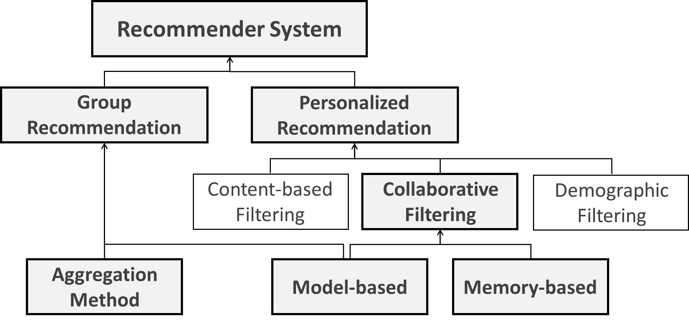
Research interest Recommender system
II
Young-Duk Seo
Taxonomy of the recommender system
(Matrix factorization)
(K-nearest neighbor)

Slide 9
Research interest Personalized recommender system
II
Young-Duk Seo
Personalized recommender system based on social big data
Conducted from a memory-based approach (complete)
Memory-based: collaborative filtering (CF) based on user-to-user similarity measure
Proposed a novel user-to-user closeness measure called friendship strength
Computed the similarity between users based on classifying the features of social big data
Applying friendship strength to a model-based approach (future work)
Probabilistic matrix factorization (PMF)
Tensor factorization
Convolution neural network (CNN)

Slide 10
Research interest Personalized recommender system (complete)
II
Young-Duk Seo
Classified the features of social big data for memory-based approach to calculate similarities and preference values
Three main properties
Contents generated by users, relationship information, and interaction information
Improving the recommendation quality
 | Contents generated by users | Relationship information | Interaction information
Definition | All contents on SNS that are created by the users, and their meta-information | A social circle representing directly connected relationship among users on SNS | Messages or contents exchanged between users
Example | Tweets on Twitter Posts on blog Post time of contents | The follower-followee relationship on Twitter Friend lists on Facebook | Mentions and retweets on Twitter Review sharing on Yelp Messages on Facebook
Three main properties of social big data in recommender system

Slide 11
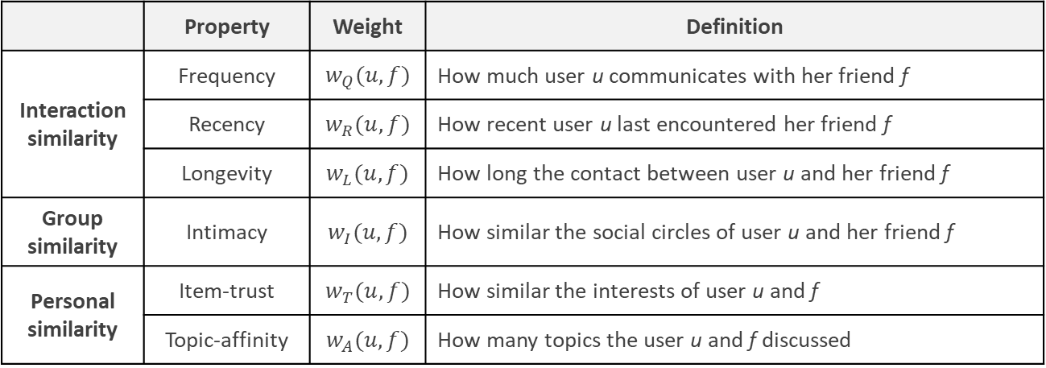
Research interest Personalized recommender system (complete)
II
Young-Duk Seo
Proposed friendship strength
An approach for measuring closeness between users that considers classified features of social big data
 | Property | Weight | Definition
Interaction similarity | Frequency | $$w_{Q}(u, f)$$ | How much user u communicates with her friend f
 | Recency | $$w_{R}(u, f)$$ | How recent user u last encountered her friend f
 | Longevity | $$w_{L}(u, f)$$ | How long the contact between user u and her friend f
Group similarity | Intimacy | $$w_{I}(u, f)$$ | How similar the social circles of user u and her friend f
Personal similarity | Item-trust | $$w_{T}(u, f)$$ | How similar the interests of user u and f
 | Topic-affinity | $$w_{A}(u, f)$$ | How many topics the user u and f discussed
Representation and definition of friendship strength

Slide 12
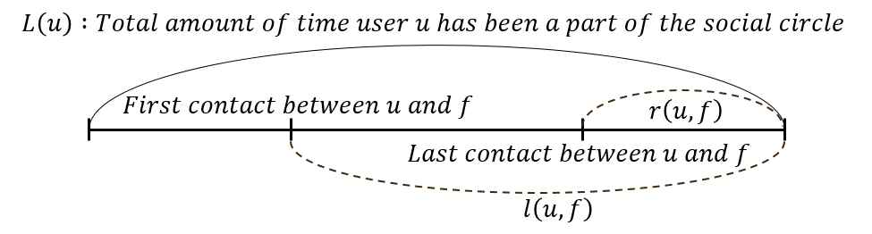
Research interest Personalized recommender system (complete)
II
Young-Duk Seo
Interaction similarity
Measured “the breath and the depth of interaction” between users
< Frequency >
< Recency >
< Longevity >
< Concept of functions L(u), r(u,f) and l(u,f) >

Slide 13
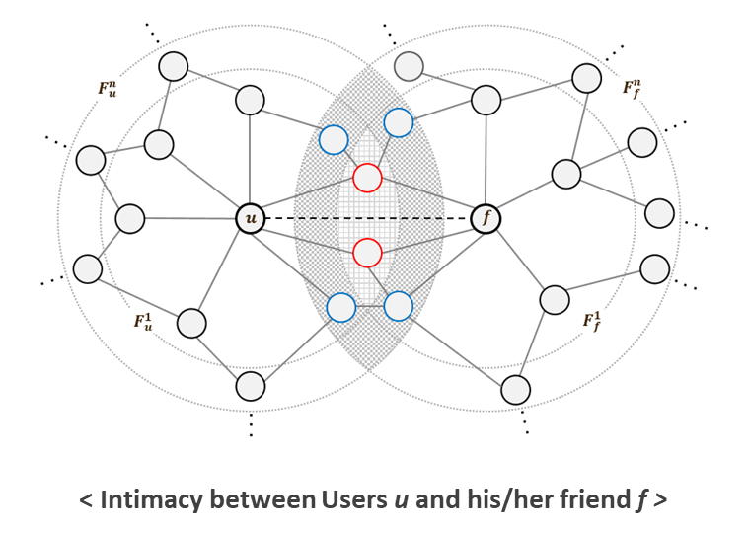
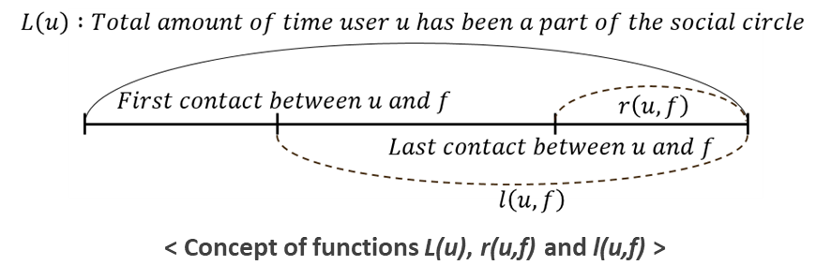
< Frequency >
< Recency >
< Longevity >

Slide 14
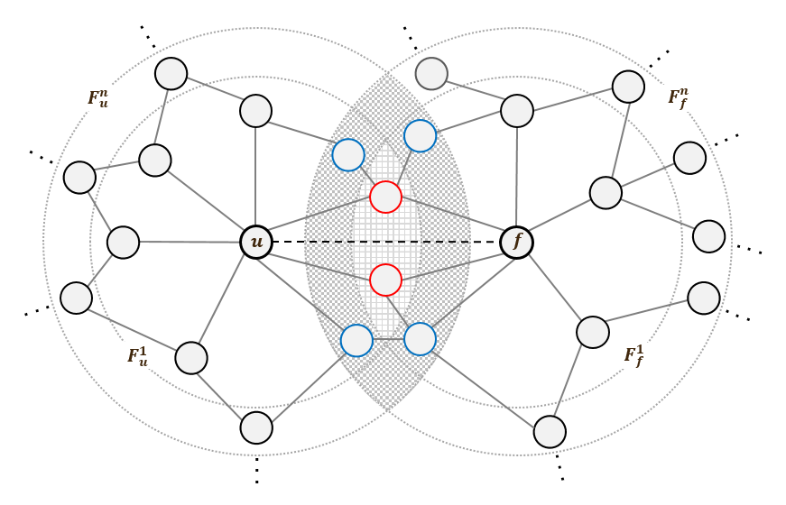
Research interest Personalized recommender system (complete)
II
Young-Duk Seo
Group similarity (intimacy)
Similarity of the social groups on SNS
< Intimacy between Users u and his/her friend f >

Slide 15
Research interest Personalized recommender system (complete)
II
Young-Duk Seo
Personal similarity
Degree of similarity between user-generated contents
< Topic-affinity >
< Item-trust >

Slide 16
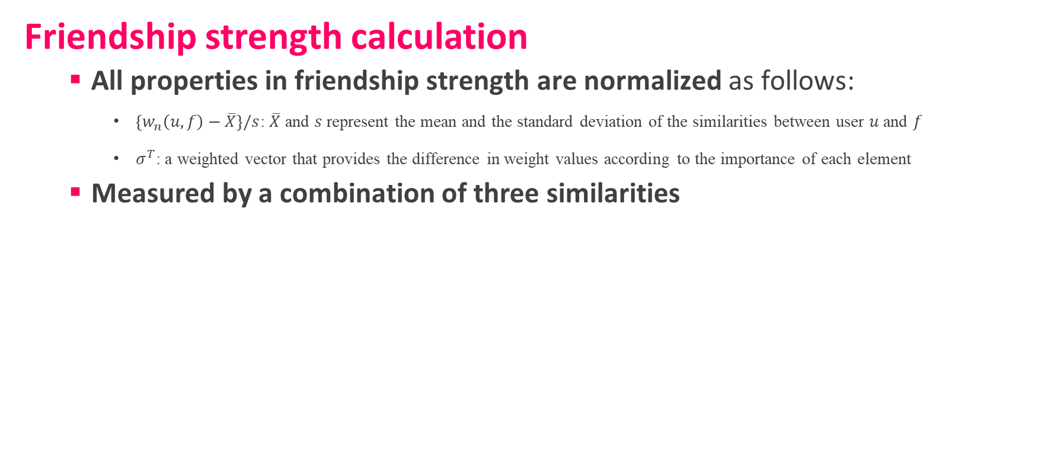
Research interest Personalized recommender system (complete)
II
Young-Duk Seo
Friendship strength calculation
All properties in friendship strength are normalized as follows:
$\left\{w_{n}\left(u,f\right)−\overline{X}\right\}/s$: $\overline{X}$ and $s$ represent the mean and the standard deviation of the similarities between user $u$ and $f$
$σ^{T}$: a weighted vector that provides the difference in weight values according to the importance of each element
Measured by a combination of three similarities

Slide 17
Research interest Personalized recommender system (complete)
II
Young-Duk Seo
Personalized recommender algorithm
The proposed personalized recommender algorithm is primarily based on memory-based CF, and uses friendship strength as a similarity measure

Slide 18
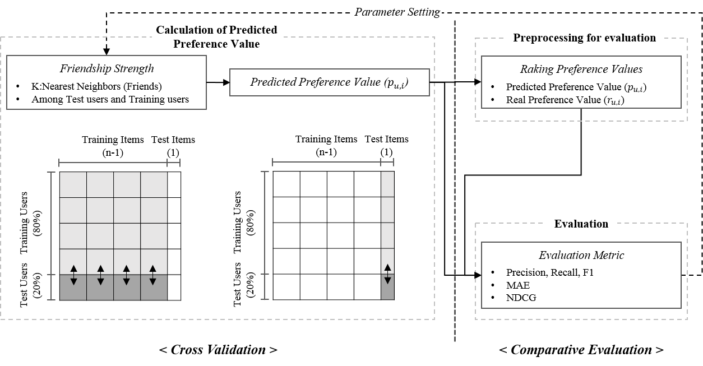
Research interest Personalized recommender system (complete)
II
Young-Duk Seo
Comparative experiments
Data set
One month of twitter data provided by a data analysis company in Korea
One million crawled Korean contents and approximately 6,000 users
Cross validation
20% test users and 80% train users
Leave-one-out cross validation for items
Baselines
CF based on existing similarity metrics
PCC, JMSD
< Evaluation framework >

Slide 19
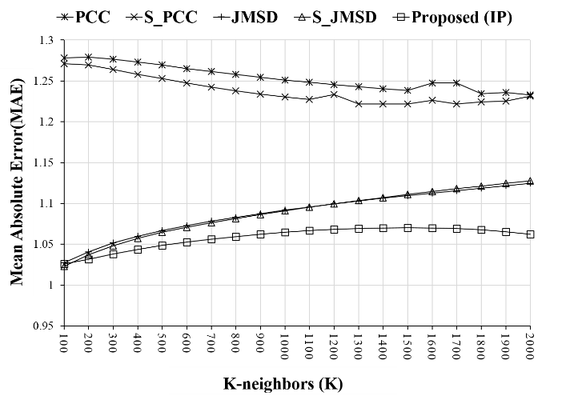
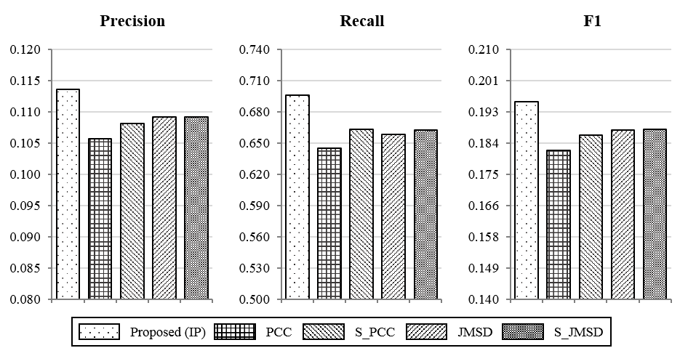
Research interest Personalized recommender system (complete)
II
Young-Duk Seo
Evaluation metrics
Mean absolute error (MAE)
Evaluate the accuracy of the predicted value computed by recommender algorithms
Precision, recall, and F1-measure
Measure the users’ satisfaction with the recommended results
Normalized discounted cumulative gain (NDCG)
Consider mainly the relevance of high ranked items
 | NDCG@k
 | k=5 | k=10 | k=20
PCC | 0.7978 | 0.8588 | 0.8779
S_PCC | 0.7963 | 0.8578 | 0.8771
JMSD | 0.7963 | 0.8576 | 0.8736
S_JMSD | 0.7986 | 0.8584 | 0.8752
Proposed (IP) | 0.8039 | 0.8607 | 0.8784

Slide 20
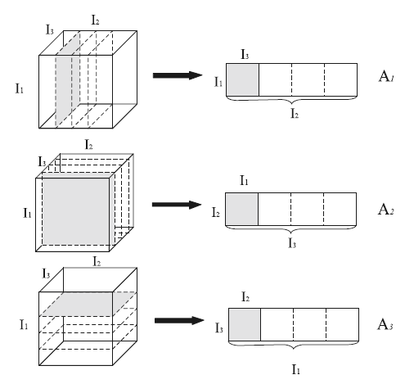
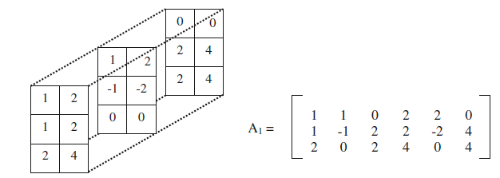
Research interest Personalized recommender system (future)
II
Young-Duk Seo
Applying friendship strength to a model-based approach
Probabilistic matrix factorization (PMF)
Most widely used in model-based approach due to its accuracy and low time complexity
Tensor factorization
Useful way for conducting sophisticated analysis via N-dimensions matrix (N > 2)
Convolution neural network (CNN)
State-of-the-art deep learning method for recommender system
Users
=
Users
x
d
Items(Ratings)
Items(Ratings)
d
< Concept of matrix factorization >
< Concept of tensor factorization >

Slide 21
Research interest Group recommender system (complete)
II
Young-Duk Seo
Group recommender system based on aggregation method
The goal of group recommendation
Given a group of users, satisfy as many users as possible with the recommended items
Aggregation method: aggregating individual preferences of group users to recommend items to a group
Several aggregation methods exists
Average (Avg), approval voting (AV), average without misery (AwM), etc.
Most methods highly depend on high average or several rating counts
Users | Items
 | i₁ | i₂ | i₃ | i₄ | i₅
u₁ | 2 | 3 | 5 | 4 | ▪
u₂ | 3 | 2 | 5 | 4 | 3
u₃ | 2 | ▪ | 1 | 3 | 4
Avg | 2.33 | 2.5 | 3.67 | 3.67 | 3.5
AV | 0 | 0 | 2 | 2 | 1
AwM | ▪ | ▪ | ▪ | 3.67 | 3.5
< Example of existing aggregation method >

Slide 22
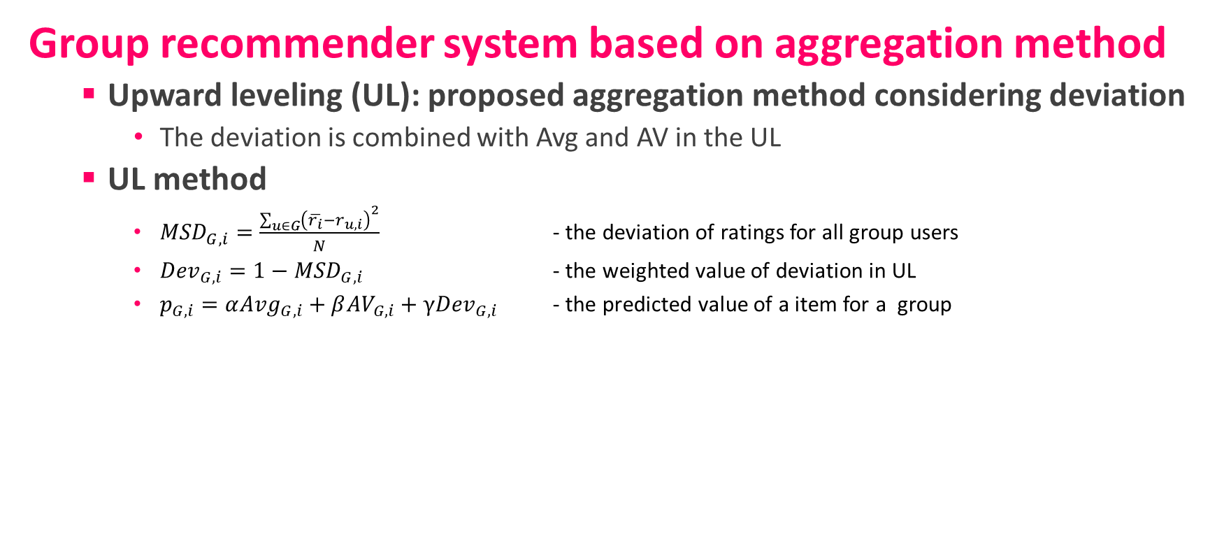
Research interest Group recommender system (complete)
II
Young-Duk Seo
Group recommender system based on aggregation method
Upward leveling (UL): proposed aggregation method considering deviation
The deviation is combined with Avg and AV in the UL
UL method
${MSD}_{G,i}=\frac{\sum_{u∈G}{{\left(\overline{r_{i}}−r_{u,i}\right)}^{2}}}{N}$ - the deviation of ratings for all group users
${Dev}_{G,i}=1−{MSD}_{G,i}$ - the weighted value of deviation in UL
$p_{G,i}=α{Avg}_{G,i}+β{AV}_{G,i}+γ{Dev}_{G,i}$ - the predicted value of a item for a group
< A framework for the proposed group recommendation >

Slide 23
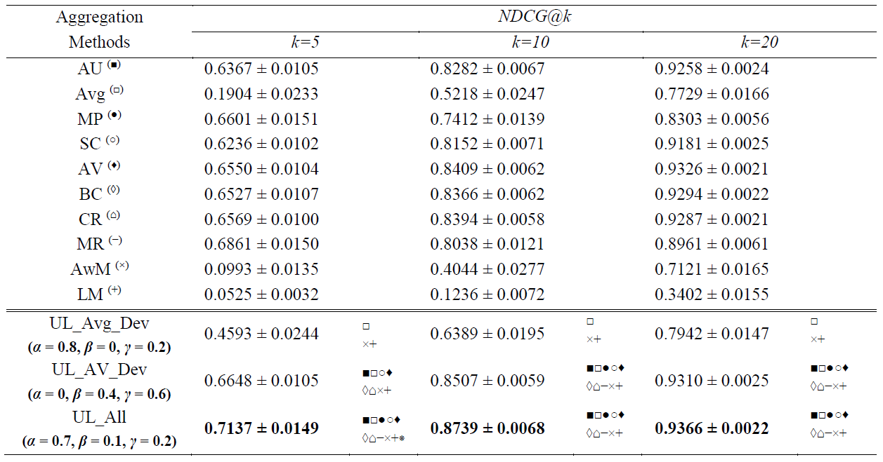
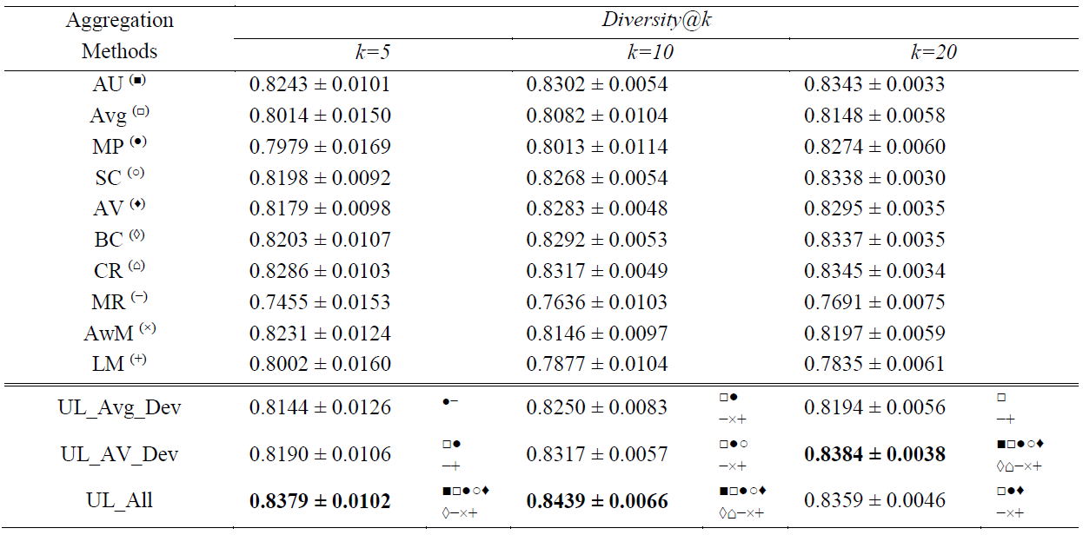
Research interest Group recommender system (complete)
II
Young-Duk Seo
Group recommender system based on aggregation method
Comparative experiments were preformed in small and large group sizes (e.g., 4, 8, 16, 32, and 64)
Based on NDCG and diversity to validate the effectiveness of the UL
< Experimental results when the number of groups corresponds to 4 >

Slide 24
Research interest Group Recommender System (Future)
II
Young-Duk Seo
Group recommender system via MF
Utilizing matrix factorization techniques to discover groups and find the preferred items quickly
Defining a set of closely located users as a group
Group vector is the center of the group
Finding items closed to the group vector, and recommending such items to a group
G1
User latent feature vector
Item latent feature vector
Group latent feature vector
G2

Slide 25
Research interest Group recommender system (future)
II
Young-Duk Seo
Group recommender system via tensor factorization
Utilizing 3-dimension matrix (group x item x aggregation method)
Finding the best combination of aggregation methods
0.62 | 0.44 | … | 0.70 | 0.44
0.46 | 0.30 |  | 0.35 | 0.13
0.60 | 0.97 |  | 0.26 | 0.48
0.84 | 1.00 |  | 0.65 | 0.70
 | AM₁ | AM₂ |  | AM_{n-1} | AM_{n}
I₁ | 0.33 | 0.51 | … | 0.14 | 0.55
I₂ | 0.25 | 0.65 |  | 0.32 | 0.21
I₃ | 0.67 | 0.25 |  | 0.5 | 0.34
I₄ | 0.35 | 0.16 |  | 0.24 | 0.23
0.78 | 0.18 | … | 0.62 | 0.74
0.40 | 0.88 |  | 0.32 | 0.62
0.47 | 0.16 |  | 0.87 | 0.46
0.74 | 0.54 |  | 0.94 | 0.60
G₃
G₂
G₁

Slide 26
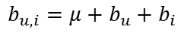
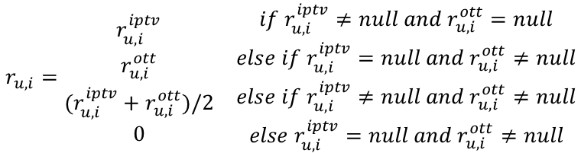
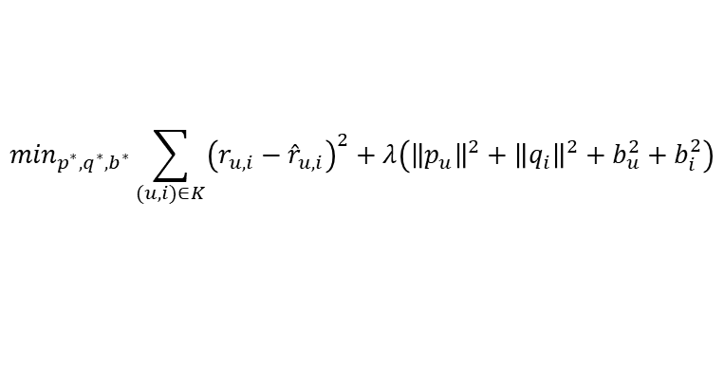
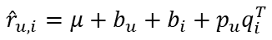
Research interest Domain specific recommender systems (ongoing)
II
Young-Duk Seo
IPTV recommender system
Worked on a joint project with Zinnaworks Inc.
IPTV and OTT services data are provided by them
Proposing IPTV VOD recommender system via data integration of IPTV and OTT services
Extending explicit rating value to solve data sparsity issue
Utilizing PMF, which is flexible enough to guarantee high performance in most domains
Validating our system by using real world data sets for IPTV and OTT services
$$r_{u,i}=\begin{matrix}\begin{matrix}r_{u,i}^{iptv} \\ \begin{matrix}r_{u,i}^{ott} \\ (r_{u,i}^{iptv}+r_{u,i}^{ott})/2 \\ 0\end{matrix}\end{matrix} & \begin{matrix}if r_{u,i}^{iptv}≠null and r_{u,i}^{ott}=null \\ \begin{matrix}else if r_{u,i}^{iptv}=null and r_{u,i}^{ott}≠null \\ else if r_{u,i}^{iptv}≠null and r_{u,i}^{ott}≠null \\ else r_{u,i}^{iptv}=null and r_{u,i}^{ott}≠null\end{matrix}\end{matrix}\end{matrix}$$
$$b_{u,i}=μ+b_{u}+b_{i}$$
$${\hat{r}}_{u,i}=μ+b_{u}+b_{i}+p_{u}q_{i}^{T}$$
$$\min_{p^{∗},q^{∗},b^{∗}}\sum_{(u,i)∈K}{{\left(r_{u,i}−{\hat{r}}_{u,i}\right)}^{2}+λ\left({\left\|p_{u}\right\|}^{2}+{\left\|q_{i}\right\|}^{2}+b_{u}^{2}+b_{i}^{2}\right)}$$
Integrated rating of user for item
Recommender algorithm utilizing PMF

Slide 27
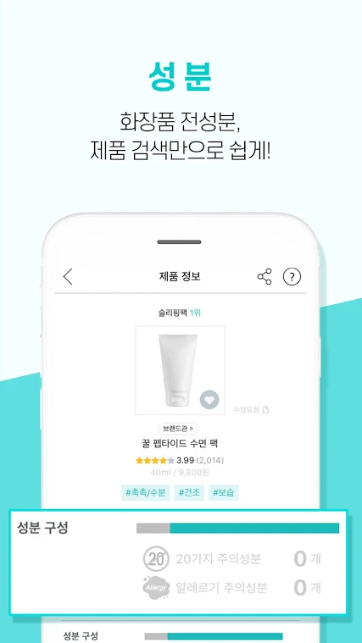
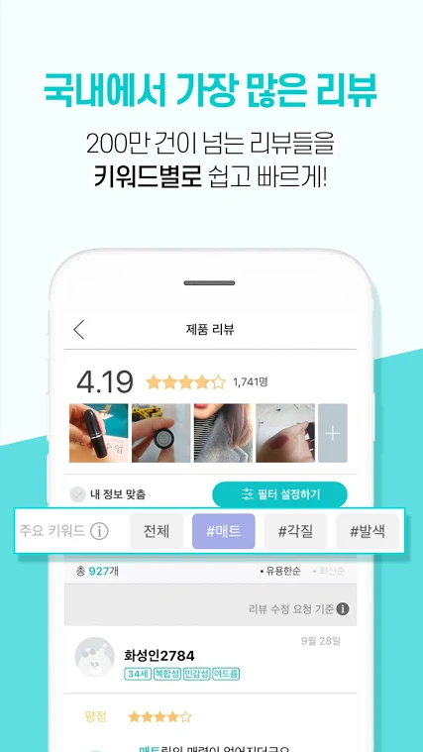
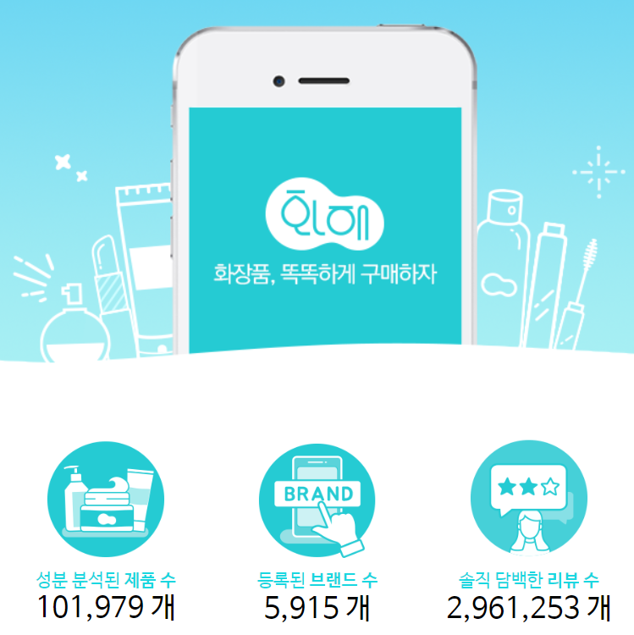
Research interest Domain Specific Recommender Systems (future)
II
Young-Duk Seo
Cooperating with other various companies
BIRDVIEW Inc. is a company founded by my high school friends
Serves an application providing the information of cosmetics
The quality of application service could be improved with recommender system

Slide 28
Young-Duk Seo
II. Research interests 2
Recommender system | Big data analysis | Smart greenhouse

Slide 29
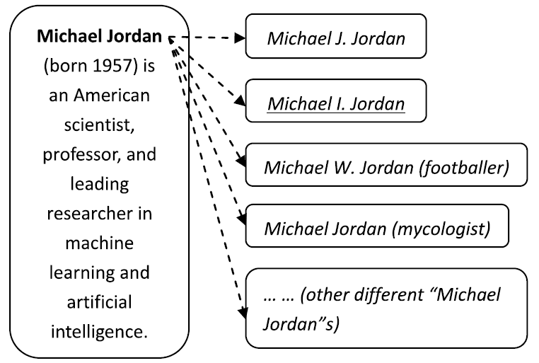
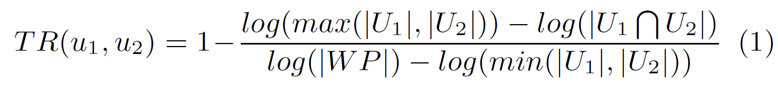
Research interest Entity linking for short textual data (complete)
II
Young-Duk Seo
What is entity linking?
Link an entity appearing in web text with their corresponding entity in a structured knowledge base (e.g., Wikipedia, DBpedia, YAGO, and Freebase)
Main purpose of entity linking: finding a suitable entity
Main issue in entity linking: resolving entity ambiguity
Utilizing Wikipedia link-based measure (WLM)
Text
Candidate entities
Measuring topical coherence between two entities in Wikipedia
Most entity linking research are based on web texts
Using short textual data, such as tweets and reviews in entity linking is an interesting research topic
Resolving data sparseness issue
< Example of entity linking & entity ambiguity>

Slide 30
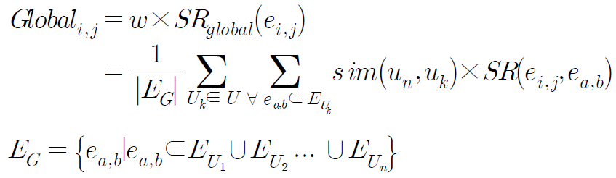
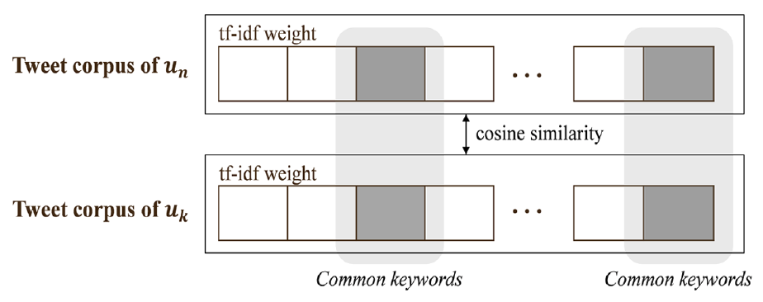
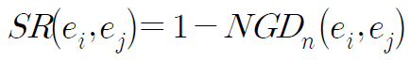
Research interest Entity linking for short textual data (complete)
II
Young-Duk Seo
Extended the corpus of target users to utilize data from highly similar users and improve the linking accuracy
Existing research extended the corpus to deploy only a set of user’s own data
Utilized the corpus of highly similar users for extending corpus
To solve data sparseness issue
Validated that this method improved the linking accuracy
e_{i}
e_{i}

Slide 31
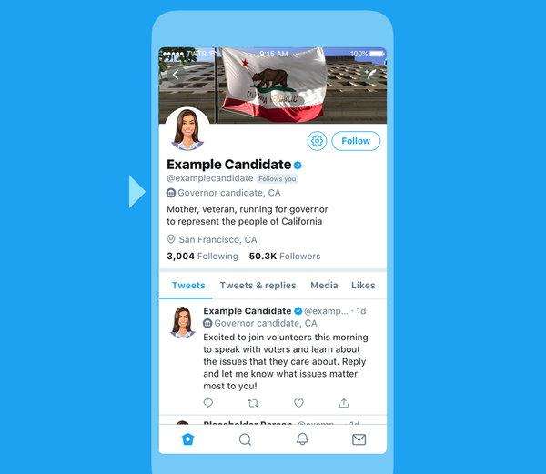
Research interest Entity linking for short textual data (future)
II
Young-Duk Seo
Discovering a set of similar short textual data, not users
Finding data of target user and other users that are similar to the target data
Unnecessary short textual data is not included in the data set, which is regarded as a corpus
Only contain relevant data in a corpus
The meaning of entity is extracted by this corpus
Data set of a target user
Target short textual data
Short textual data1
Short textual data2
Short textual data3
Data set of other users

Slide 32
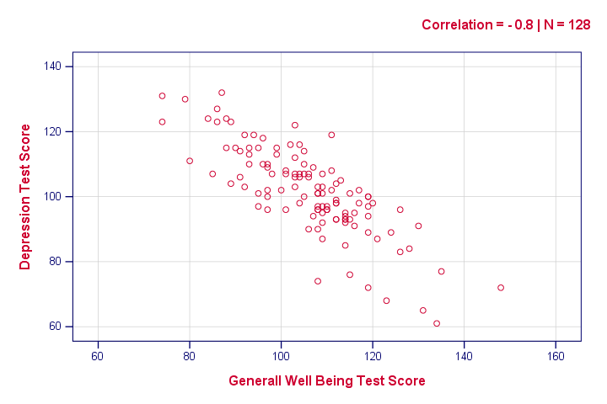
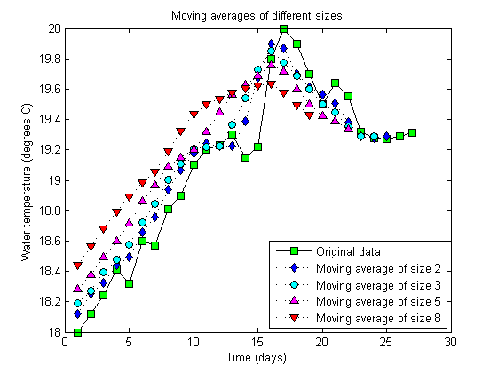
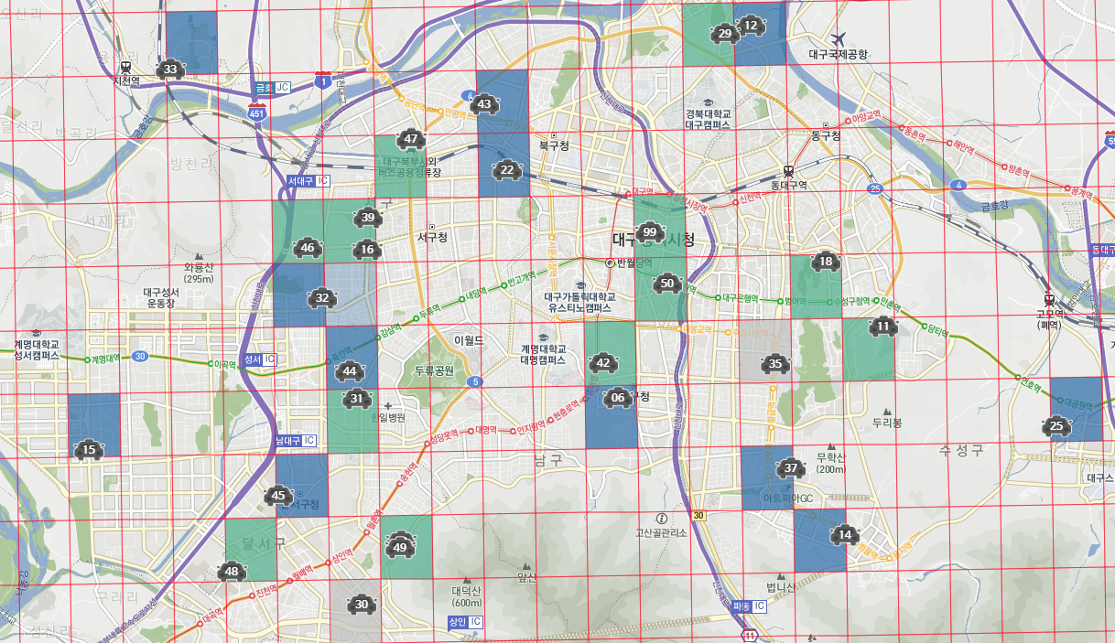
Research interest Data analysis based on real big data set (future)
II
Young-Duk Seo
Visual analytics for fine dust data analysis
Making a fine visualized website
Measuring correlations between fine dust and various diseases
Predicting fine dust concentration and the diseases caused by fine dust
Incidence of specific disease
Fine dust concentration
Correlation analysis
Prediction of fine dust and diseases
Existing website to show the collected fine dust data

Slide 33

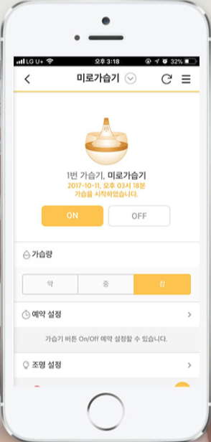

Research interest Data analysis based on real big data set (future)
II
Young-Duk Seo
Visual analytics for IoT data
Humidity data analysis
Co-working with Miro Inc.
They have collected humidity and users data via their IoT chip
Computing correlation analysis between indoor humidity and infant health

Slide 34
Young-Duk Seo
II. Research interests 3
Recommender system | Big data analysis | Smart greenhouse

Slide 35
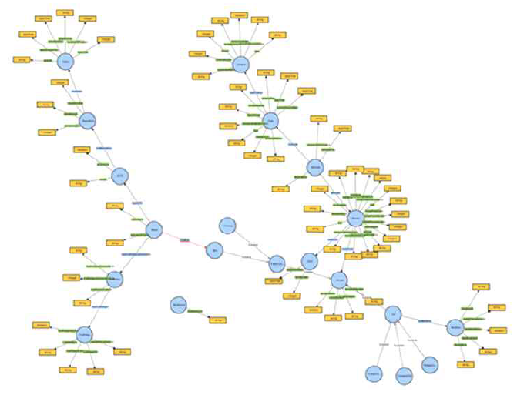
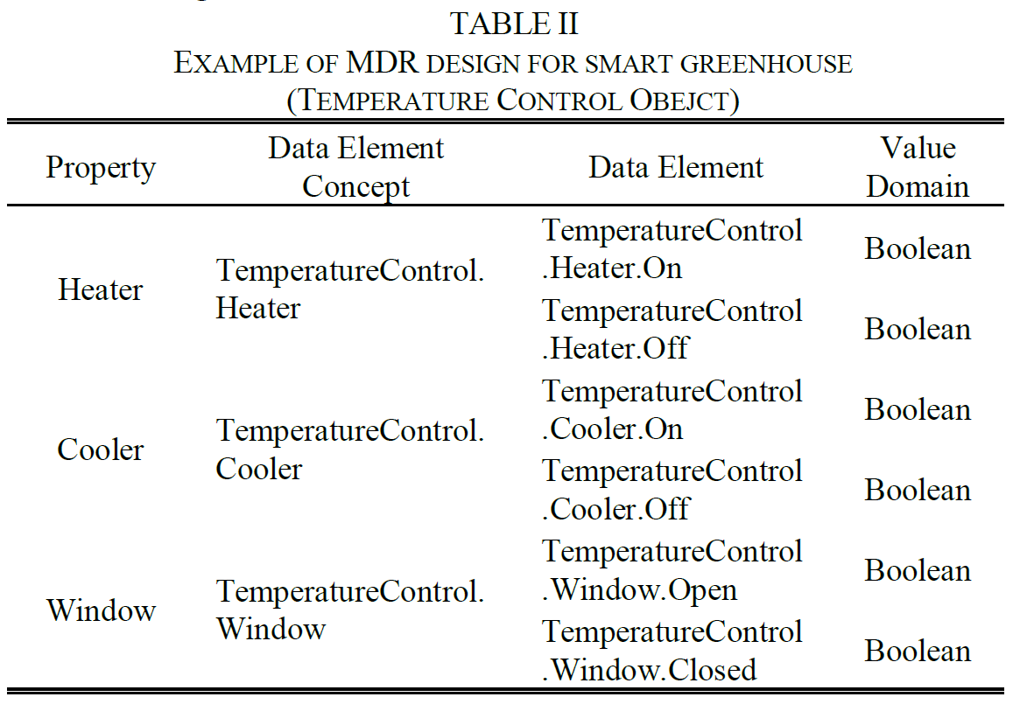
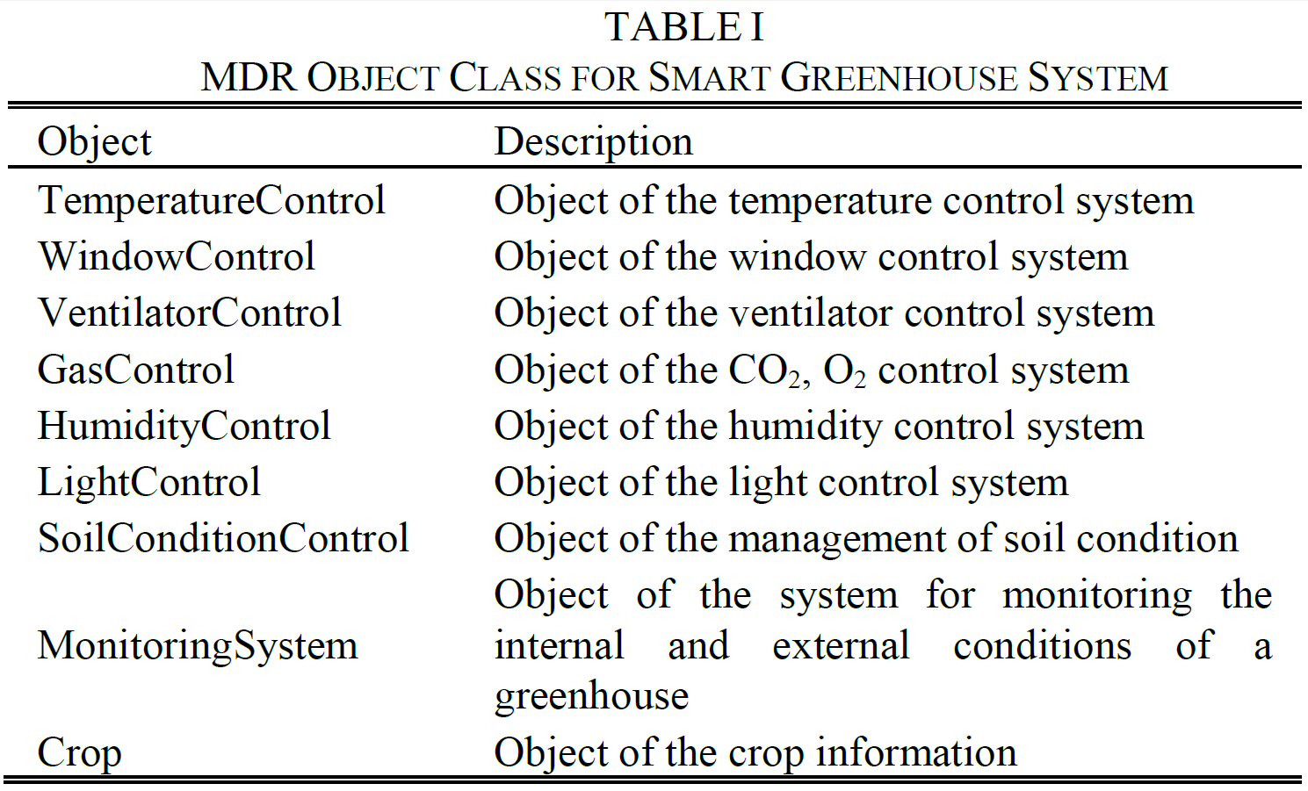
Research interest Design of smart greenhouse (complete)
II
Young-Duk Seo
Defined AK for a smart greenhouse, and managed the AKs to use an ontology repository based on MDR
AK (Adaptation knowledge)
Context information, automatic control strategies, and information of crops
Registration of the AK in the MDR
Management of AK’s metadata
MDR-based ontology repository
Expressed connection between the AKs

Slide 36
Research interest Scenario for smart greenhouse (future)
II
Young-Duk Seo
Designing a scenario for automatically control the interior environment of a greenhouse based on the MAPE-K model
Monitoring (M)
Collecting context information of the greenhouse through sensors
Analysis (A)
Determining when the internal environment of greenhouse needs to change
Plan (P)
Selecting the optimal automatic control strategy when environmental changes in the greenhouse are needed
Execute (E)
Operating the control system based on automatic control strategy
Knowledge (K): AKs

Slide 37
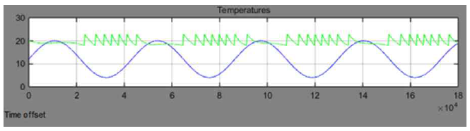
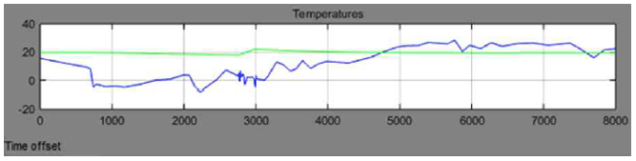
Research interest Validation of smart greenhouse (future)
II
Young-Duk Seo
Verification of proposed smart greenhouse through simulation
Using a simulation tool to derive simulation results
With MDR expert, verifying the designed AK
Developing actual smart greenhouse system as a proto-type
Simulation result according to the artificial temperature change
Simulation result according to the actual temperature change
Simple simulation results for controlling temperature

Slide 38
Young-Duk Seo
III. Lecture Plan

Slide 39
Lecture plan List of teaching interests
II
Young-Duk Seo
Data structure based on C language
Teaching at Korea university for sophomore
Team project
Build a graph using open data, and implement graph theory
Web programing
Teaching at Sungshin Women’s university for freshman
Team project
Propose web site providing services that you think you need based on HTML5

Slide 40
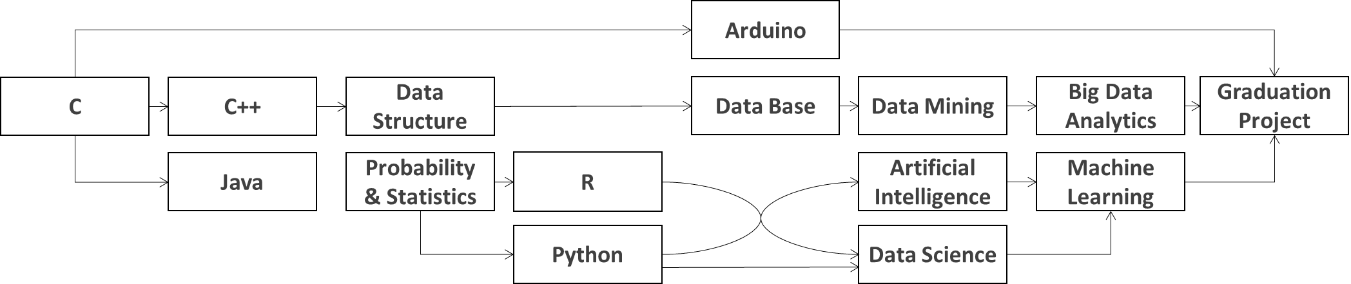
Lecture plan List of teaching interests
II
Young-Duk Seo
Linear algebra
Freshman
Sophomore
Junior
Senior
Programming languages, such as C, C++, Java, R, and Python
Base courses for computer science, such as data structure, data base, and A.I.
Advanced courses required for machine learning, such as probability & statistics and linear algebra
Machine learning course: use Stanford ML online course and teach students more easily
Advanced courses for big data, such as data mining, data science, and big data analytics
Graduation project: writing papers for recommender system or big data analysis, and developing smart greenhouse using Arduino or programs that IT companies want

Slide 41
Thank You!

